Slide 1

WEBSITE
PRESENTATION
Prepared by:
ANDI, Mufida Omar (C0864756)
ESPIÑA, Sylvia De La Pena (C0866311)
LU, Tich Vu (C0861736)
REDDY, Ajay Ambharapu Kumar(C0865533)
SHAH, Jay (C0868053)
VARMA, Jenil Shivamkumar (C0870543)

Slide 2
WEBSITE OVERVIEW
RASVEL's is an e-commerce website offering various products from Clothing, Electronics, Kitchen, and Groceries. It is committed to providing the finest low-price shopping experience possible by delivering excellent products at low costs in a bright, easy-to-navigate store.
Group 5

Slide 3
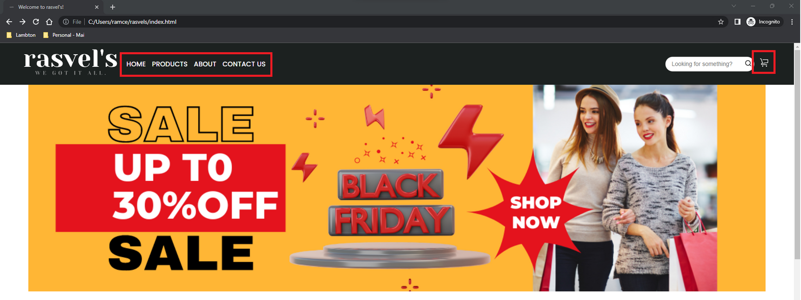
NAVIGATION
All pages on the website have a navigation area that will allow users to navigate the different web pages.
Group 5

Slide 4
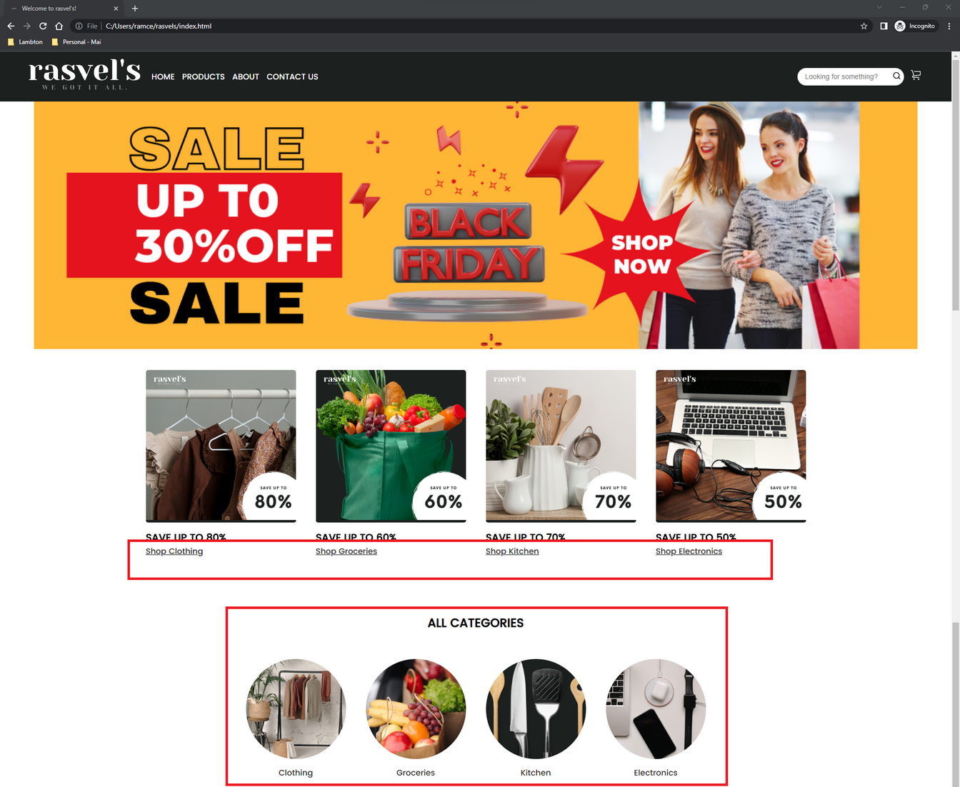
HOME
The Home Page displays a shortcut for each product category the store offers.
List of product categories:
Clothing
Groceries
Kitchen
Electronics
Group 5

Slide 5
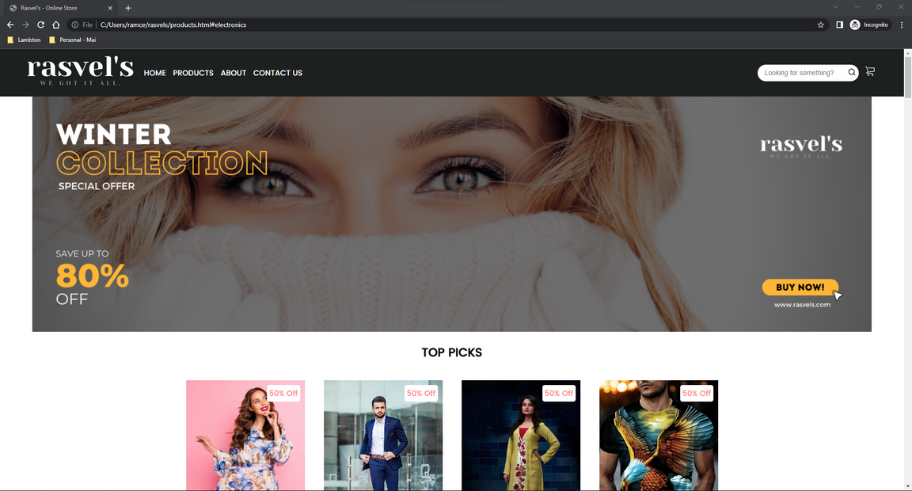
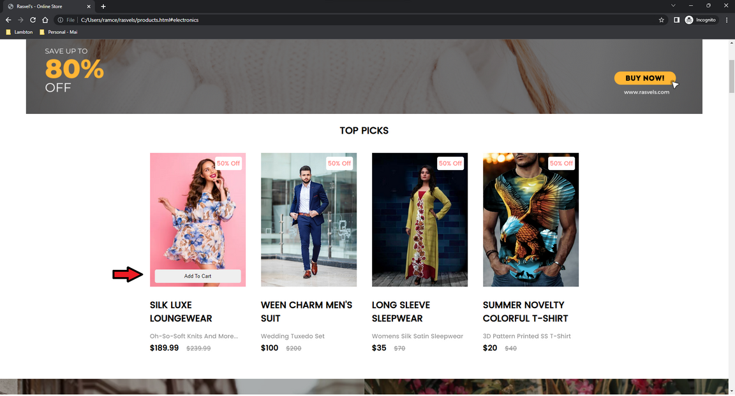
PRODUCTS
The Products Page displays the top picks and list of products under each category. Once the user hovers over a product, an Add To Cart button will be displayed, allowing the user to add the product to their cart.
Group 5

Slide 6
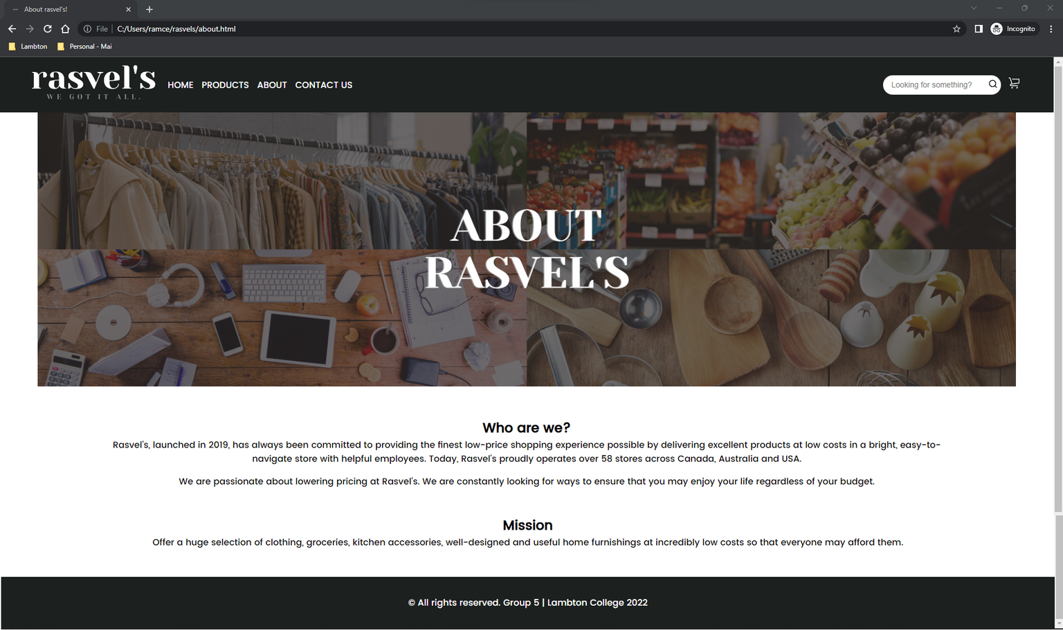
ABOUT
The About Page displays a brief description of the store and it's mission.
Group 5

Slide 7
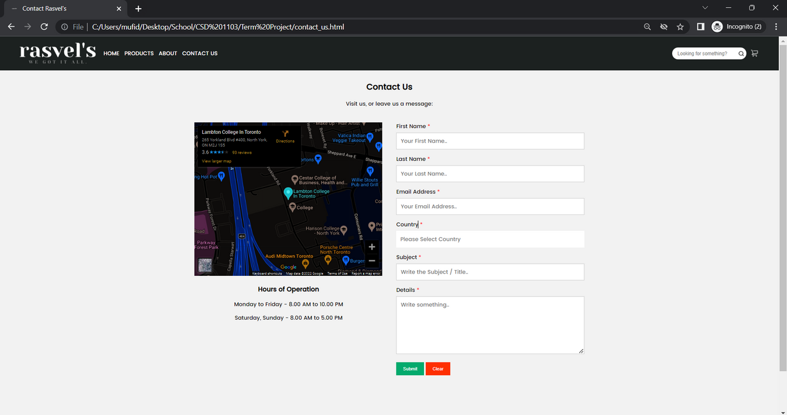
CONTACT US
The Contact Us Page displays a map and hours of operation for users to know when and where they can locate the store's main headquarter. A contact form is also available for users to leave any questions, clarifications, or feedback.
Group 5

Slide 8
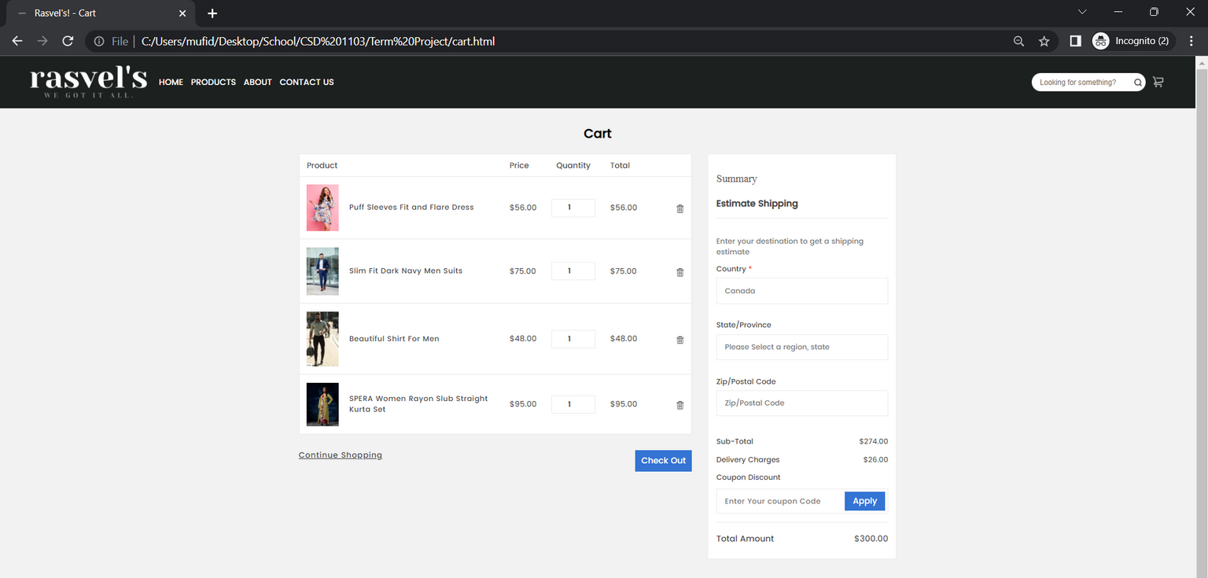
CART
Summary of Products
Group 5

Slide 9
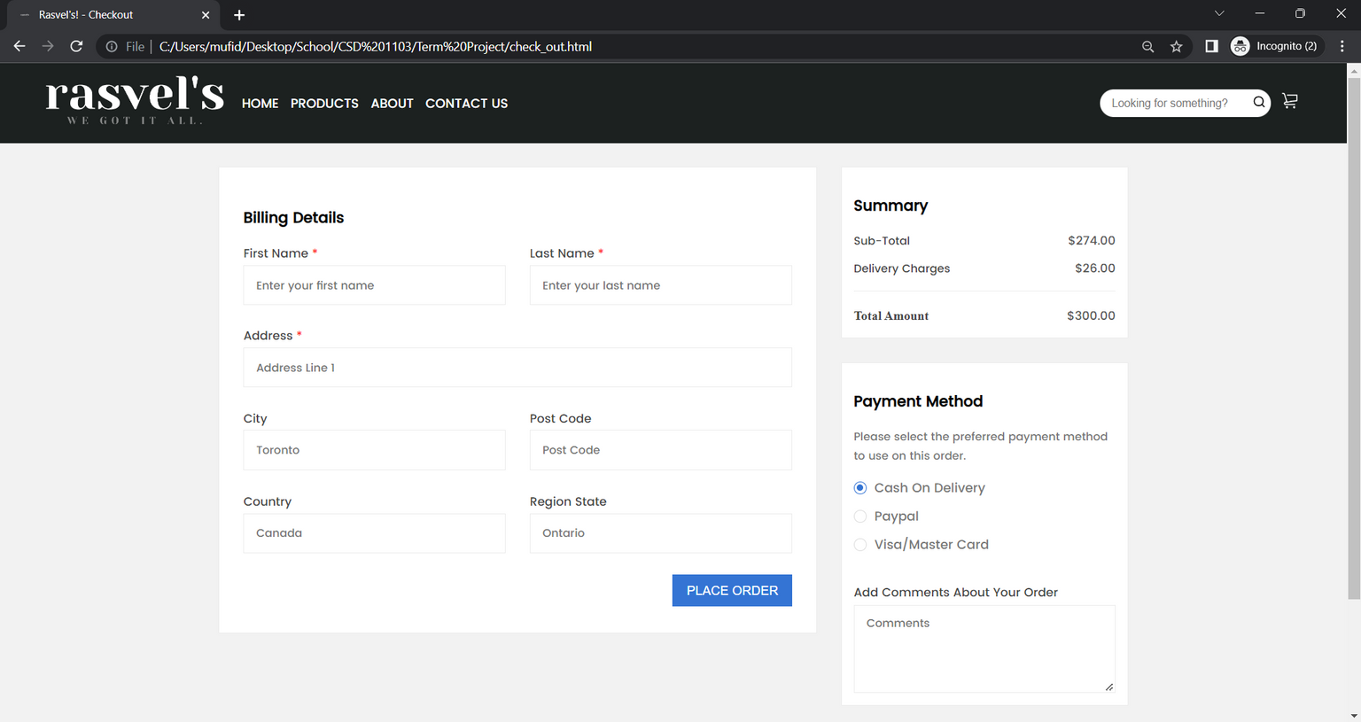
CART
Shipping Details
Group 5

Slide 10
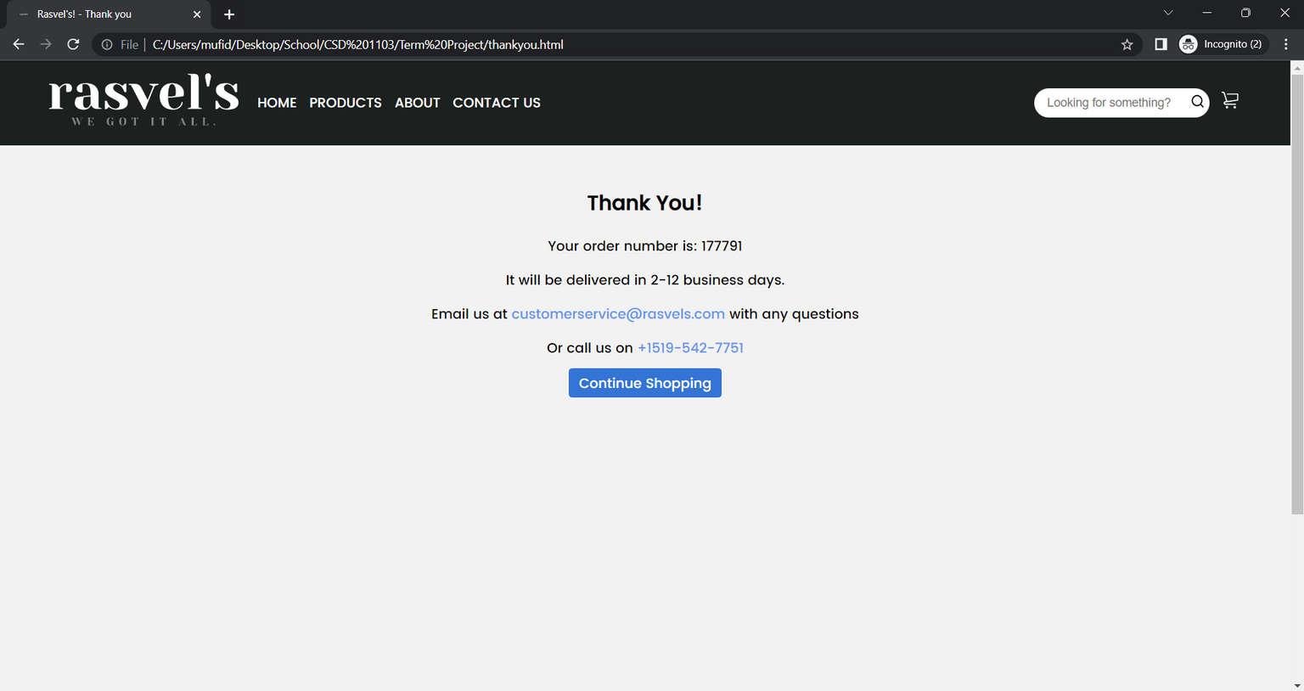
CART
Thank You Page
Group 5

Slide 11






RESPONSIVE DESIGN
Group 5

Slide 12
THANK YOU!
Group 5

